Slide 1
Automation Testing Basic Using UFT and ALM
Koushik Biswas
Wipro Automation Team
Notes:
The below and following notes on the template slides are to guide you only. In your final presentation, you may delete these notes and add relevant notes if any.
Title slide:
Title – should not exceed beyond 3 lines, font size 30-34, Arial Bold
(Font size for the title of the PPT can vary between 30-34, Arial, Bold depending on the amount of text, however should not be smaller than 30 font size)
Name should not exceed beyond 1 line, Designation; font size to remain at 16, Arial normal
Please keep the title slide simple, just the logo, title and name and designation to appear. No other graphic elements or any design, photograph, image can be added to this slide, alignment to remain the same

Slide 2
Agenda
1
Application Area : Knowledge
2
Creation of BPT Component in UFT
3
Creation of Automation Script in ALM
Creation of Data Table in ALM
Test Result Analysis in ALM
Notes:
Agenda slide:
Heading – Agenda - Font size 30, Arial Bold
Please restrict this slide with just 5 agenda points. If you have more than 5 points on the agenda slide please add another slide. If you have only 3 then you can use just one slide and delete the other 2 points.

Slide 3
Creating Application Area and Association of it with Function Library(QFL/VBS) and Object Repository(OR) in UFT
Notes:
Section breaker slide:
Used for a section heading. You may add a sub heading not exceeding one line also here
Section heading – Arial, bold, 34 font size, should not exceed beyond 1 line
Sub Head – Arial, normal, 20 font size, should not exceed beyond 1 line

Slide 4
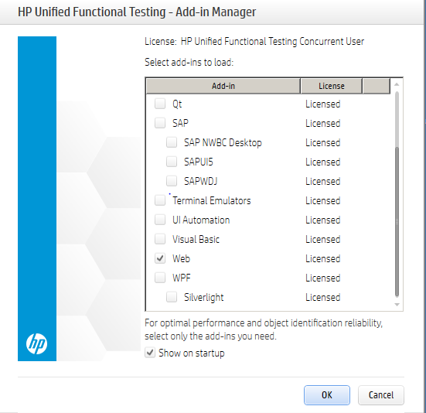
Add in Selection
Launch UFT and select respective Add in based on application type.
For instance an application say <ServiceNow>(can be any application) which is a Web based application so we can proceed by selecting Web Add in and Click OK after selection.

Slide 5
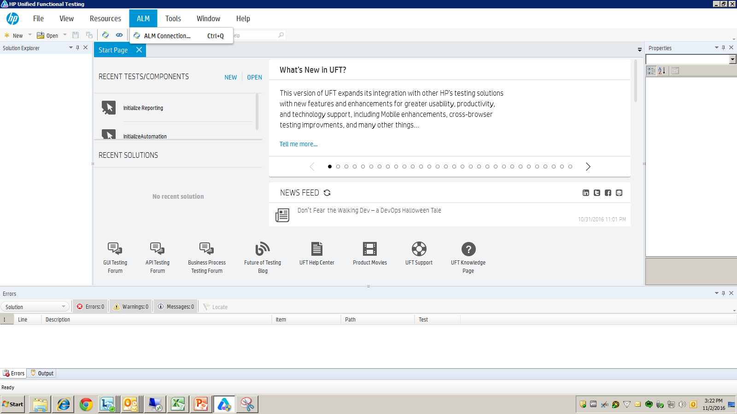
UFT connectivity with ALM
Click on ALM tab displayed at the top and Click on ALM connection menu option.

Slide 6
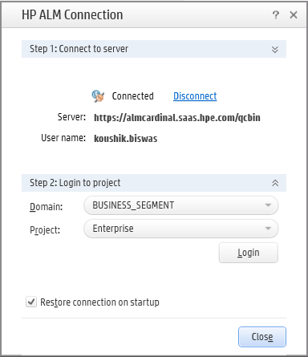
UFT connectivity with ALM(Contd.)
Enter the ALM server address.(For e.g. https://almcardinal.saas.hpe.com/qcbin/start_a.jsp)
Enter the ALM User ID and Password.
Click on Connect button to establish the connection.

Slide 7
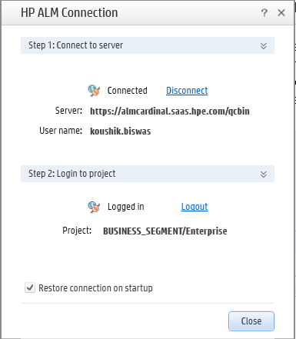
UFT connectivity with ALM(Contd.)
Select the respective Domain and Project after establishing ALM connection.
Click on Login button to log the ALM user to the respective ALM project.

Slide 8
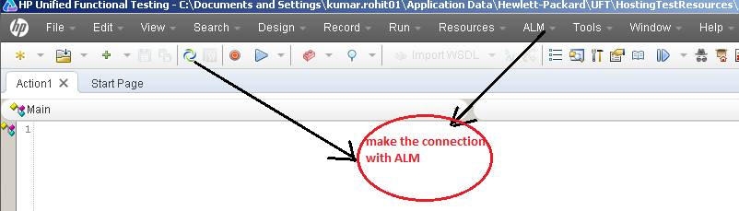
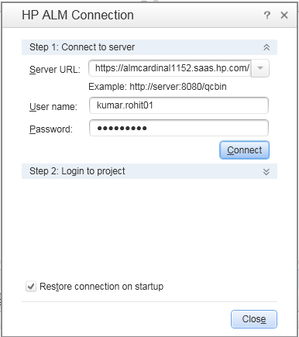
UFT connectivity with ALM(Contd.)
Notes:
Before you create or open a business component, you connect UFT to a ALM project, which is where business components and application area resources and settings are stored. Connecting to your ALM project enables UFT to create or open the business component. This also enables the business component to access all of the resources defined in the application area on which the component is based.

Slide 9
What is Application Area?
Application Area is a single point of maintenance for all elements in AUT. We can define settings, resources, start up add-ins, recovery scenarios, function libraries, object repositories etc. for easy maintenance.
In short, Application Area is a repository of all the resources subject to be referenced by automated test flows created for particular application.

Slide 10
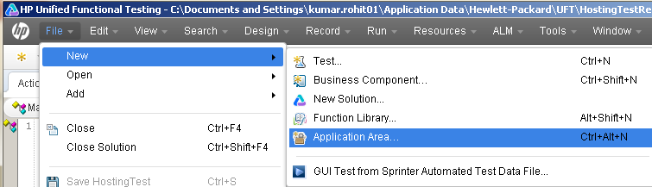
Creating Application Area
Click on File menu and Click on New menu option.
Click on Application Area…
Notes:
Blank slide or a freeform slide you may use this to insert or show screenshots etc
If content is added in this slide you will need to use bulleted text

Slide 11
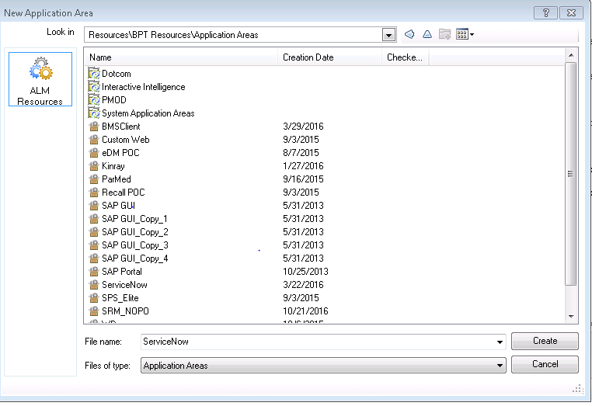
Creating Application Area(Contd.)
Enter the Application Area Name.
Click on Create button.
Notes:
Blank slide or a freeform slide you may use this to insert or show screenshots etc
If content is added in this slide you will need to use bulleted text

Slide 12
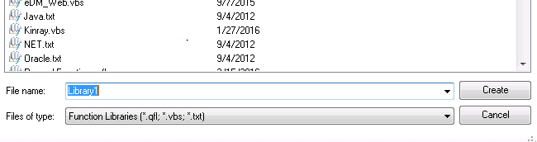
What is Function Library?
Function Library is a file comprising of the list of reusable functions, procedures which can be leveraged for building automation component.
The set of functions, procedures are usually called in the component using “Call” keyword.
The following convention helps in saving time during automation component development and increasing robustness.
The extension of function library file could be “.txt”,”.vbs”,”.qfl”

Slide 13
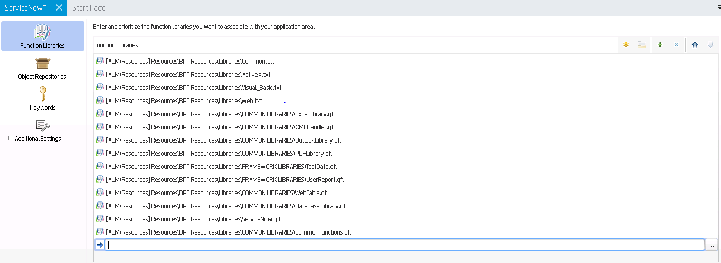
Application Area : Associating Function Library
Click on Function Libraries tab.
Click on Add Function Library(+) button located at top right corner of the panel.
Click on browse(…) to select the particular function library to map.

Slide 14
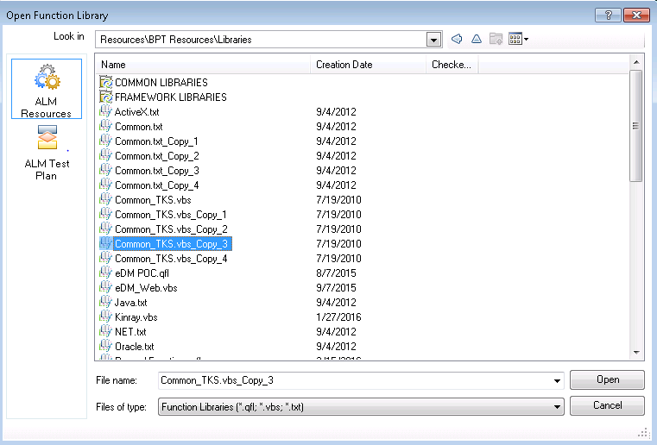
Application Area : Associating Function Library(Contd.)
Select the particular function library from ALM resources tab.
Click on Open button to get the particular library mapped.

Slide 15
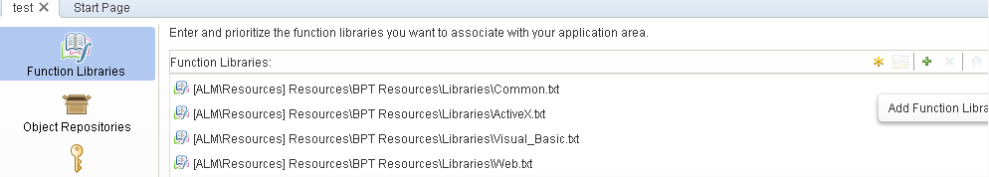
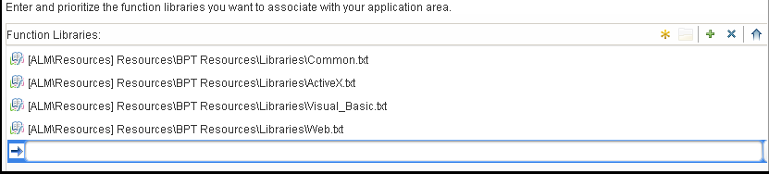
Application Area : Associating Function Library(Contd.)
Click Here to Add Function Library
Notes:
Column content slide – This is a slide with 2 columns and you can have text in bullet points under each column. You can have separate header for each of the columns in the blue box provided on top of each of the columns.
Heading font size of the column should remain at 30 and the column content should not reduce beyond 20

Slide 16
What is Object Repository?
Object Repository is a file comprising of the list of application test objects required for performing operations.
Object Repository are usually of type Local and Shared.
The extension of Shared Object Repository file is “.tsr” and for Local Object Repository file is “.mtr”
Shared Object Repository is usually a centralized repository of all the application test objects captured for all the business components automated for the application flows.
Local Object Repository is usually a local repository comprising the test objects captured for the particular business component automated for the application flows.
Local Object Repository is usually faster than Shared Object Repository at run time due to less object overheads.

Slide 17
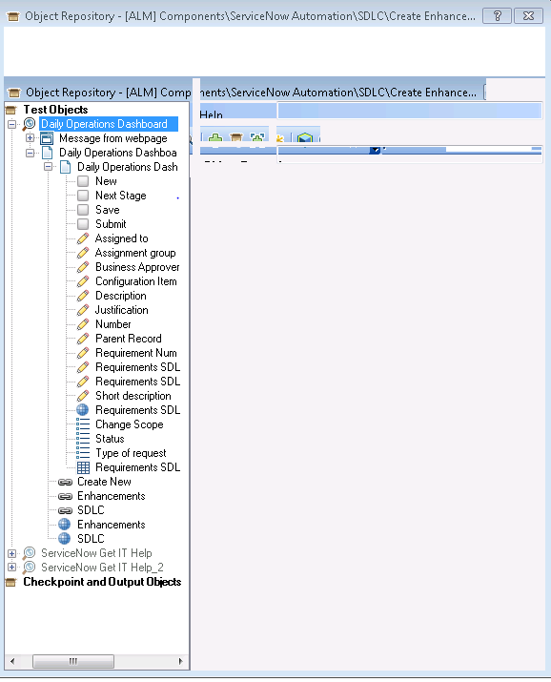
What is Object Repository?(Contd.)

Slide 18
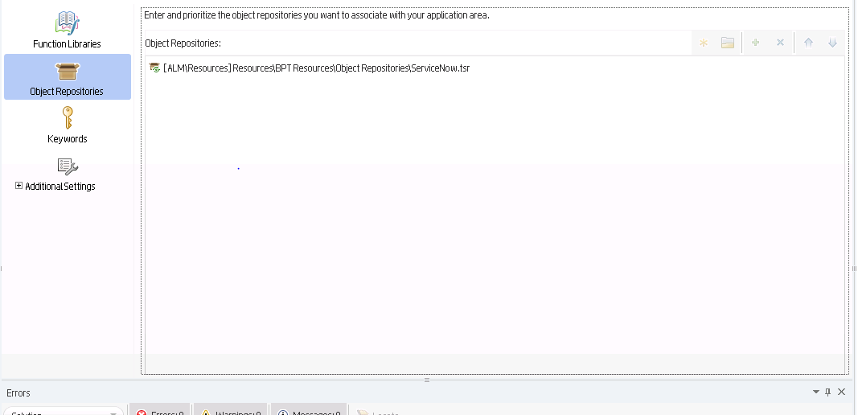
Application Area : Associating Shared Object Repository
Notes:
Column content slide – This is a slide with 2 columns and you can have text in bullet points under each column. You can have separate header for each of the columns in the blue box provided on top of each of the columns.
Heading font size of the column should remain at 30 and the column content should not reduce beyond 20

Slide 19
Business Process Testing in UFT - Overview

Slide 20
What is Business Process Testing?
Business Process Testing provides the tester with a customizable, component-based testing framework that supports - ClosedComponent reuse and modularization, ClosedCreation of tests for both simple and complex applications, and ClosedManagement of parts of a test.
In Business Process Testing, we arrange components, including keyword GUI components, scripted GUI components, or manual components in a business process test or business process flow to test different scenarios.
Business Process Testing enables the tester to arrange components to suit business needs based on modularity.
Business Process Testing is available with ALM for modularizing business components automated for any particular application.
The former process is also symbolized as “BPT driven framework”.

Slide 21
What is Business Process Test/Flow?
When working with Business Process Testing, we can use both business process tests and business process flows to organize our testing.
Each business process test or flow consists of business components, which are added and ordered (or grouped) together.
When UFT runs a business process test, it runs each of the components and their steps in sequence.
A business process test is a scenario comprising a sequence of business components or flows, designed to test a specific scenario in an application.
A flow is a type of test that comprises a logical set of business components, in a fixed sequence, that performs a specific task.
When designing flows, they can be considered as “Compound Components"

Slide 22
Creating BPT Component in UFT

Slide 23
BPT Component creation Pre-Requisites
To work with BPT from within UFT, tester must first connect to an ALM project with BPT support.
Application Area should be created as business components use application areas to store settings and resources that may be required by multiple components, such as shared object repositories and function libraries.
Components are automatically linked to all of the resources and settings defined in the associated application area.
ALM should be BPT licensed in order to proceed with the Business component creation.

Slide 24
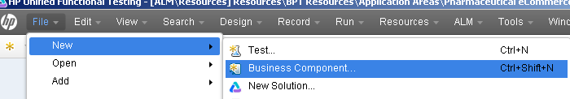
Steps for creating BPT Component in UFT
Click on File menu and Click on New menu option.
Click on Business Component…

Slide 25
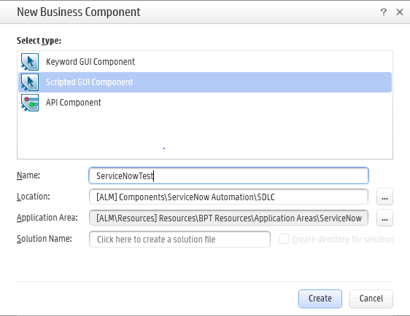
Steps for creating BPT Component in UFT(Contd.)
Select the type i.e. Scripted GUI Component.
Enter the Component name.
Enter the ALM folder path location for saving the component.
Associate the respective Application Area to the particular component.
Click on Create button.

Slide 26
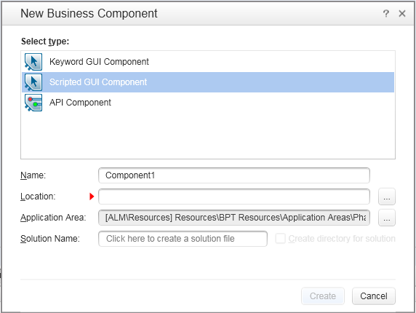
Creation of BPT Component (Revised)
ALM folder path
Location of Application Area

Slide 27
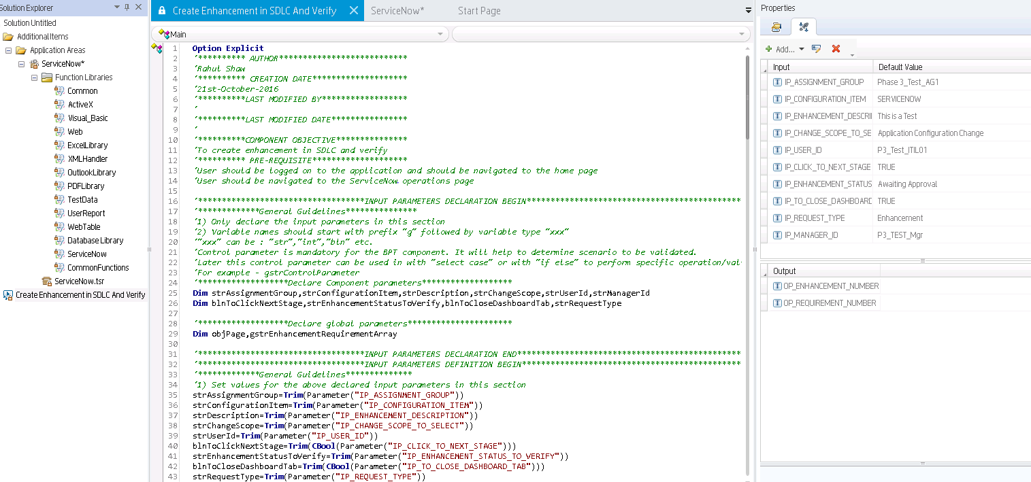
Creation of BPT Component (Revised)
Notes:
Option Explicit - Mandates the variable declarations for respective Business Component.
Dim - Used for declaring data members/variables used inside respective Business Component.
Properties pane - Located at the extreme right used for portraying the list of input and output parameters and component properties.
Parameters - 1) As per the proper convention input parameters should be prefixed with “IP” and output parameters should be prefixed with “OP”.
2) During creation, parameters should be defined in Upper Case for better readability.

Slide 28
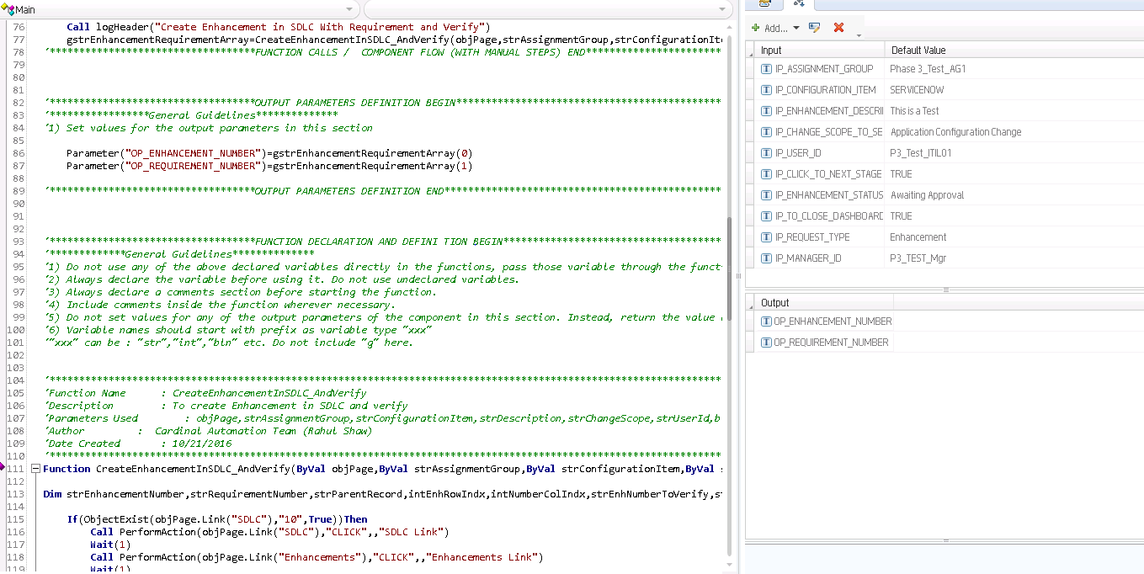
Creation of BPT Component (Revised)

Slide 29
Template for Creating BPT Component and Checklist

Slide 30
Creating Scripts in ALM based on Business Components

Slide 31
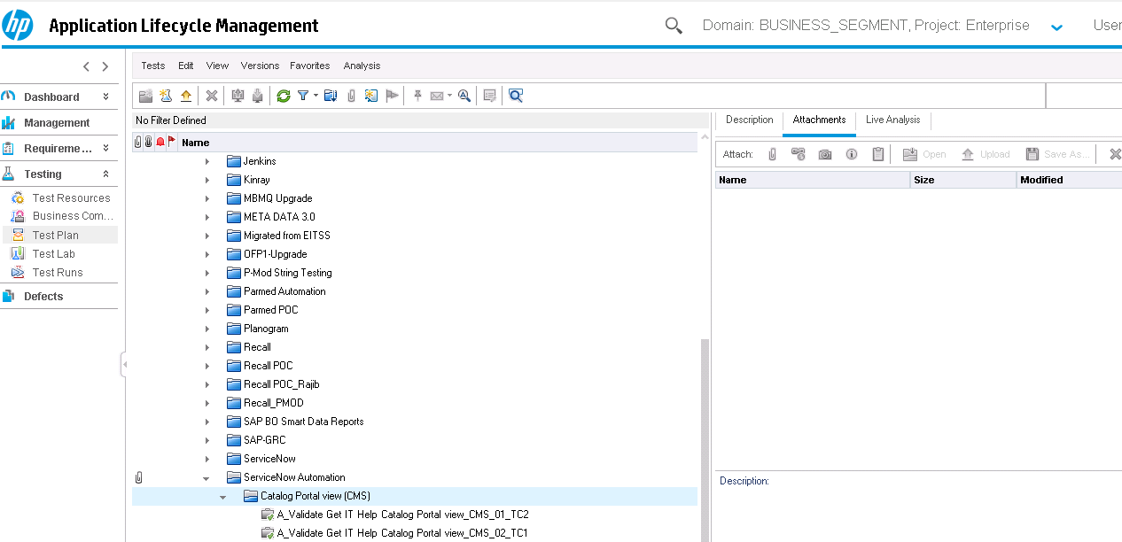
Creating Test Scripts in ALM Test Plan
Navigate to the ALM Test Plan section.
Select the respective folder to place the particular test script.
Click on New Test button displayed at the top left pane.

Slide 32
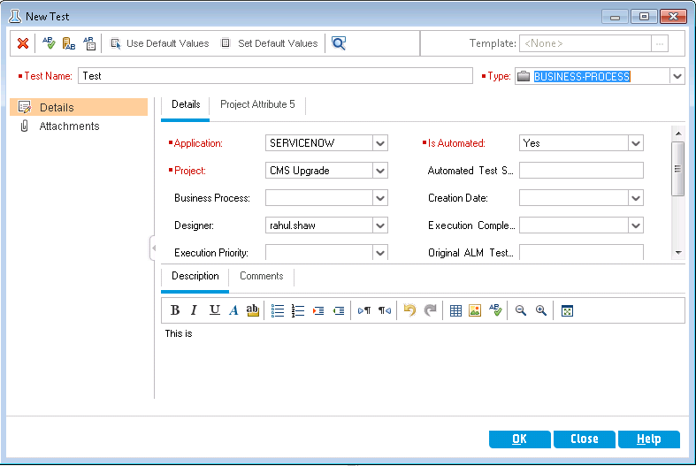
Creating Test Scripts in ALM Test Plan(Contd.)
Enter name of the Test Script.
Select the Type as “BUSINESS-PROCESS”.
Provide valid inputs for all the mandatory fields/attributes.
Enter the appropriate description for test script.
Click on OK button to proceed with the script creation.

Slide 33
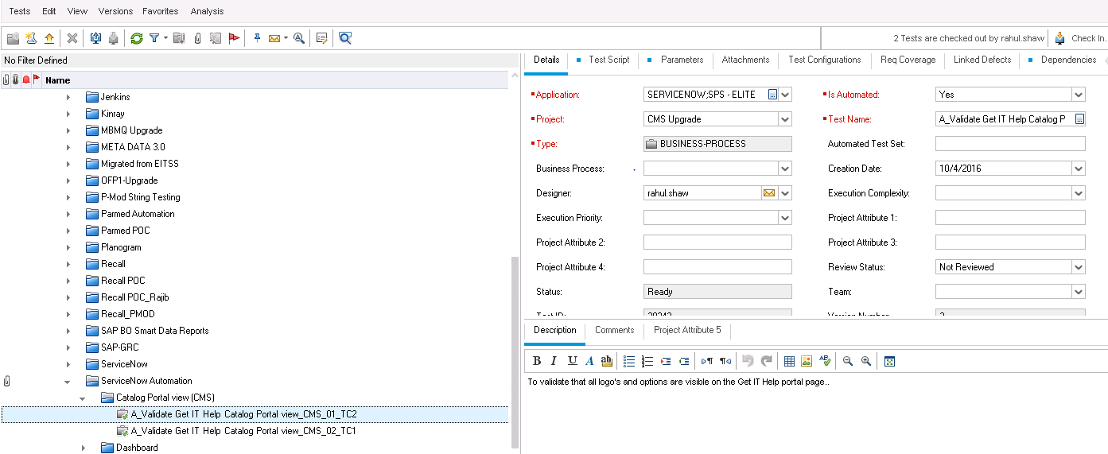
Creating Test Scripts in ALM Test Plan(Contd.)

Slide 34

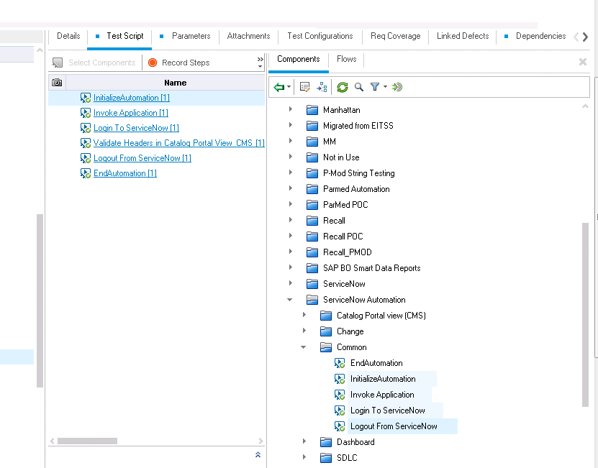
Creating Test Scripts in ALM Test Plan(Contd.)
Click on “Select Components” button.
Select the set of components to be mapped into the test script and click on Quick Add button..

Slide 35
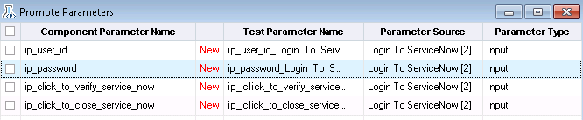
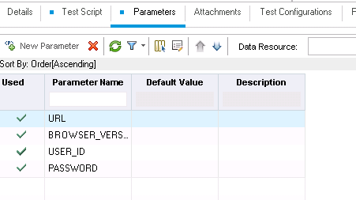

Setting Input Parameters in ALM
During component quick add we can map the component parameters to the corresponding parameter attributes created in ALM parameter section.

Slide 36

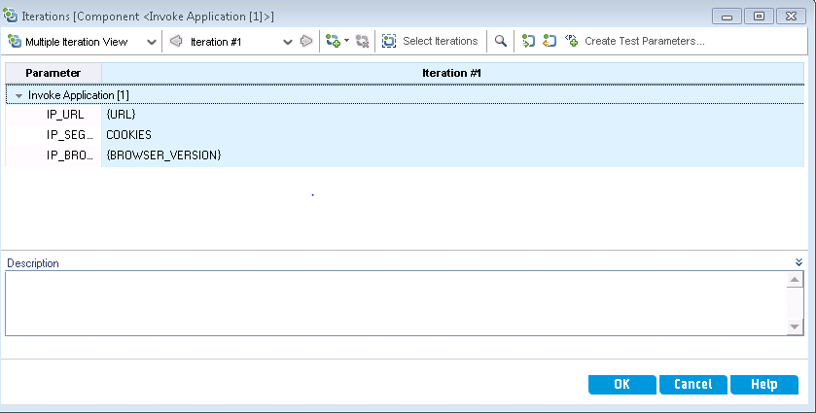
Setting Parameters Through Component Iteration link inside Test script and finalize corresponding mappings.
Click on Iterations link for any particular business component entailed in the test script.

Slide 37
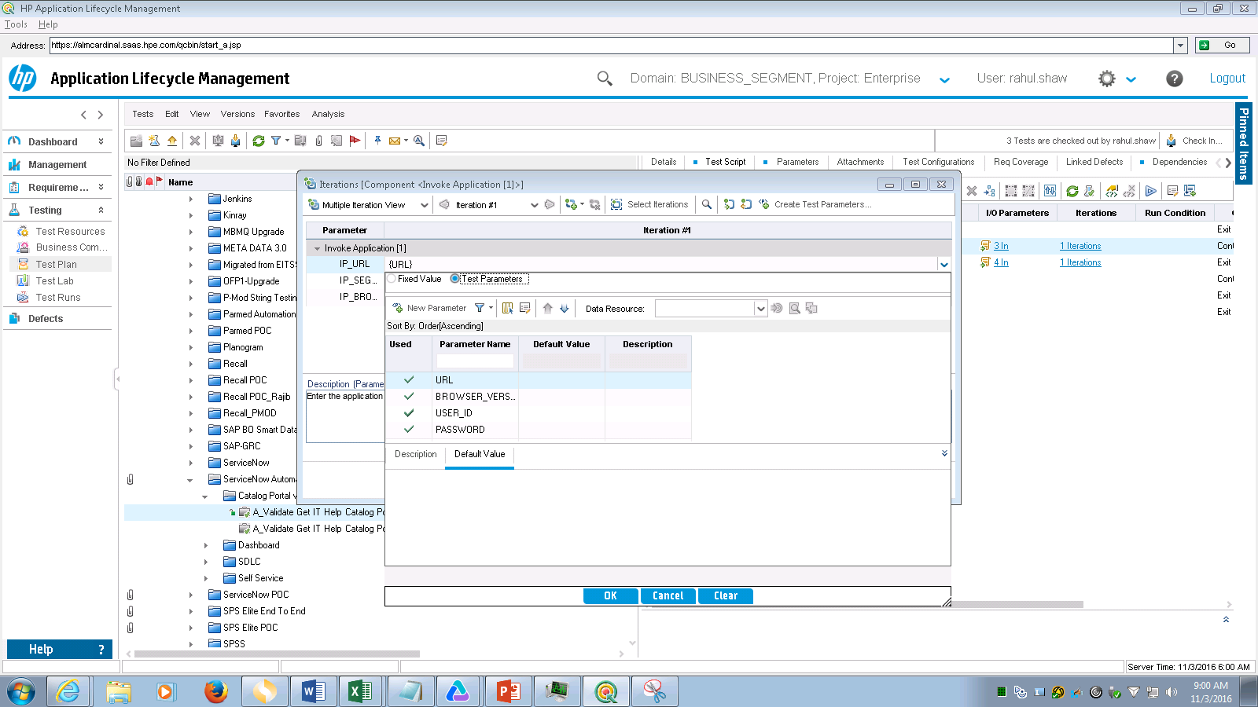
Setting Parameters Through Component Iteration link inside Test script and finalize corresponding mappings.(Contd.)
Expand the Parameter panel by clicking on downward arrow displayed extreme right.
Select Test Parameters radio button.
Select the respective parameter attribute from the ALM Parameters section.
Click on OK to get the corresponding parameter value mapped.
We can also define constant values for the component parameters instantly in case of static attributes.
Notes:
1) Tick mark indicates that component value has been mapped with ALM parameter attribute and assigned for use.
2) Attributes within { } indicates that parameter value has been mapped with ALM parameter attribute else we can provide values instantly for the component parameters in case of static attributes.

Slide 38
Creating Data Table in ALM

Slide 39
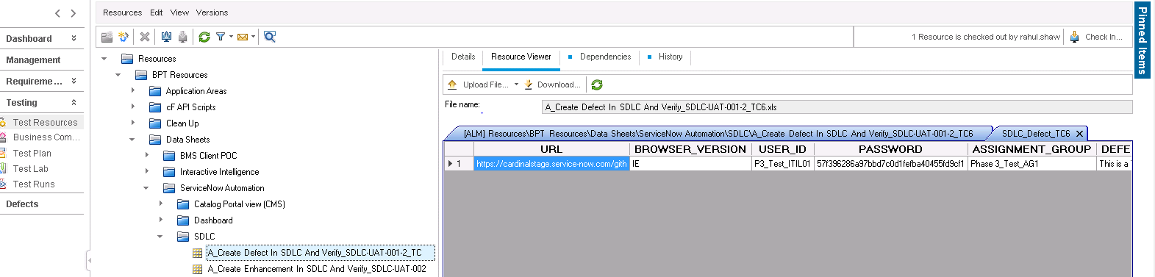
What is Data Table?
Data table is a Test resource type which comprises of external sources of data entities entailed to be used in the Test script. For e.g. Excel sheet with data row set.

Slide 40
Creating Data Table?
Navigate to ALM Test Resources section by clicking on respective tab.
Click on New Resource button displayed at the top left.

Slide 41
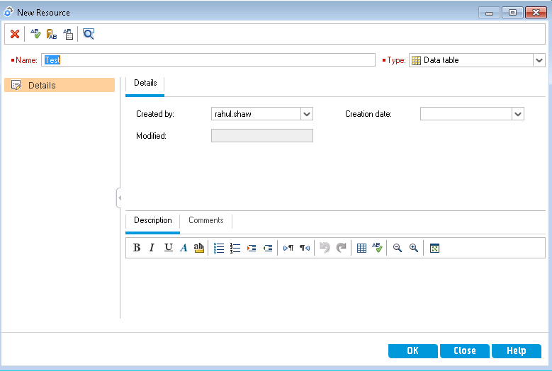
Creating Data Table?(Contd.)
Enter the Resource name for Data table.(Prefer to be same as Test script name)
Select the type as Data table.
Click on OK button to proceed with the creation.
Notes:
Create the Data table with same name as Test script name for easy identification.

Slide 42
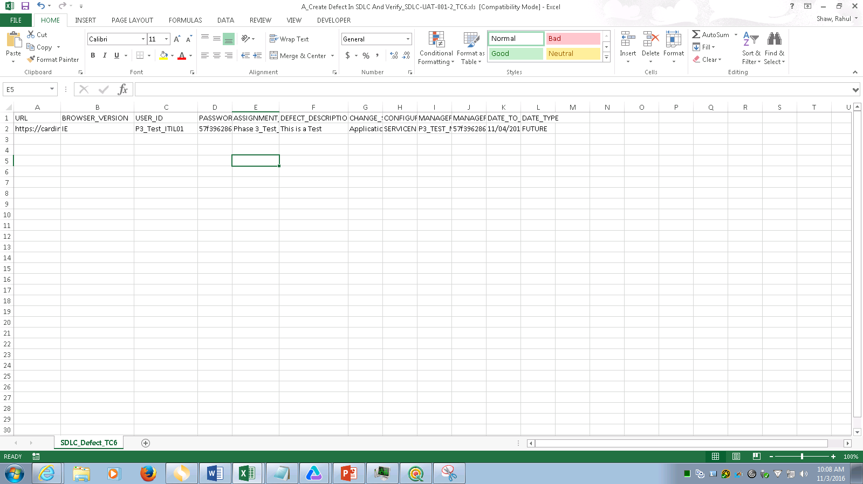
Creating Data Table?(Contd.)
Create a Excel sheet and list all the parameter attributes with corresponding value set.
Provide the file name same as Test script name followed by extension .xlsx or .xls
Notes:
Create the excel sheet file with the same name as Test script name as per the convention.
Provide an appropriate sheet name based on respective module/script id.

Slide 43
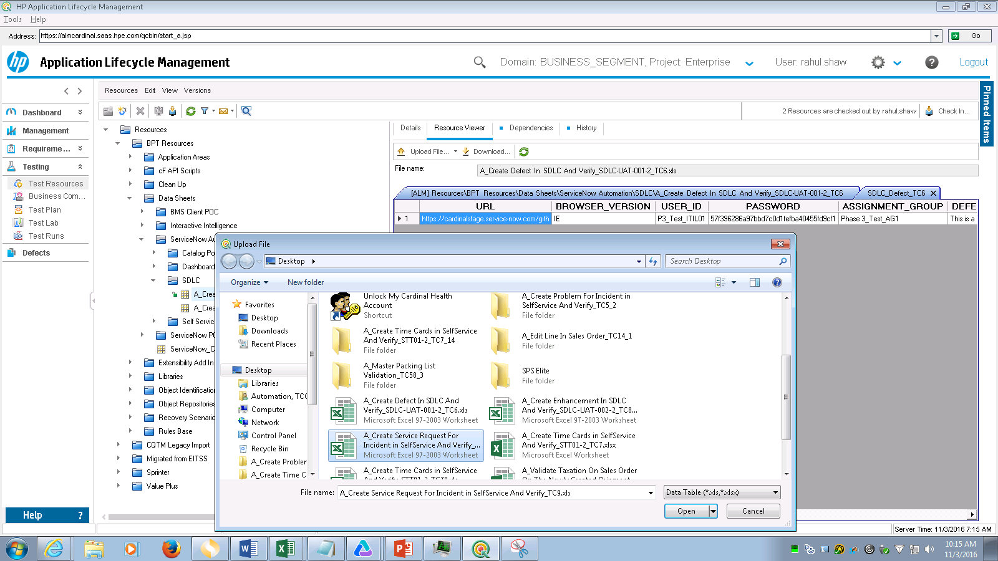
Creating Data Table?(Contd.)
Save the file after updating the values.
Click on Upload File… button displayed at the top left of the ALM resource viewer pane.
Notes:
Select the Excel file to upload and Click on Open button.
The data record set could be viewed from the particular ALM resource viewer.

Slide 44
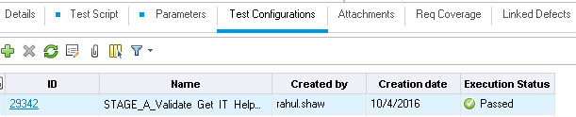
Test Configurations
Test Configurations are basically instances of data sets variable across application Environments and requirements.
For e.g. Say for a particular test script namely “A_Validate Get IT Help Catalog Portal view_CMS_01_TC2” we can maintain separate data configurations and map the corresponding to the respective during execution such that it will execute with particular instance.
Configurations are named according to the given convention that i.e. “Environment name + Test Script name.” For e.g. STAGE_A_Validate Get IT Help Catalog Portal view_CMS_01_TC2.
We can create new configuration by clicking on “+” symbol displayed at the top of Test Configurations panel
Notes:
Select the Excel file to upload and Click on Open button.
The data record set could be viewed from the particular ALM resource viewer.

Slide 45
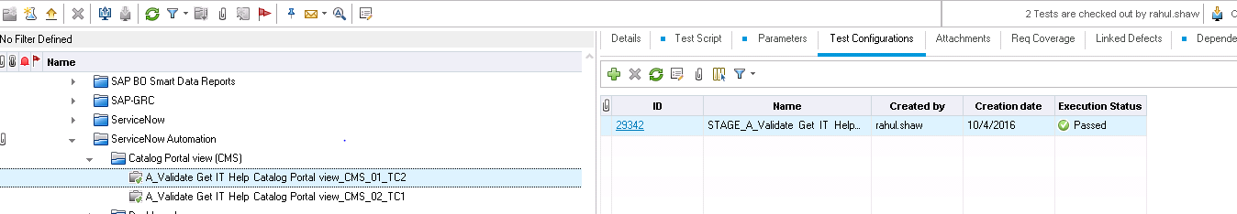
Mapping Data table to Test Configurations
Navigate to the Test Configurations panel of any particular test script.
Select the particular configuration.
Notes:
Select the Excel file to upload and Click on Open button.
The data record set could be viewed from the particular ALM resource viewer.

Slide 46
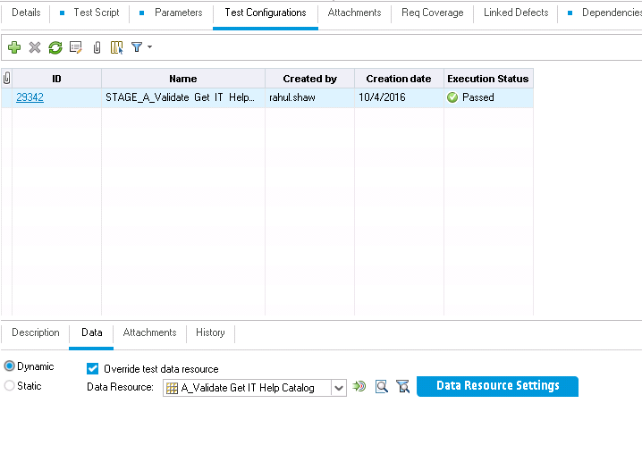
Mapping Data table to Test Configurations(Contd.)
Access the Data section in the Test Configurations panel displayed below.
Select the Dynamic radio button as data need to be referenced from external sources.
Notes:
Select the Excel file to upload and Click on Open button.
The data record set could be viewed from the particular ALM resource viewer.

Slide 47
Mapping Data table to Test Configurations(Contd.)
Access the Data section in the Test Configurations panel displayed below.
Ensure that the Override test data resource check box is checked.
Select the Dynamic radio button as data need to be referenced from external sources.
Notes:
Select the Excel file to upload and Click on Open button.
The data record set could be viewed from the particular ALM resource viewer.

Slide 48
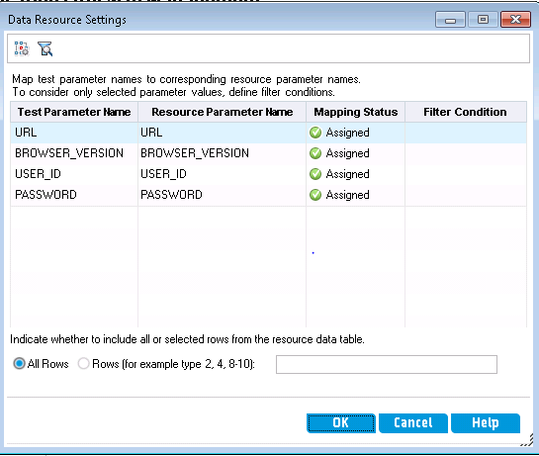
Mapping Data table to Test Configurations(Contd.)
Click on Data Resource Settings button to proceed with the test parameter mapping with the parameter values in the data table.
Map the corresponding parameter values and Click on OK button.
Notes:
Select the Excel file to upload and Click on Open button.
The data record set could be viewed from the particular ALM resource viewer.

Slide 49
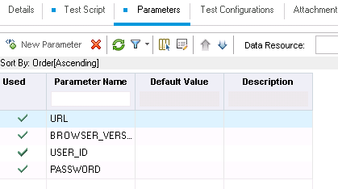
Mapping Data table to Test Configurations(Contd.)
Navigate to the Parameters tab and validate whether all the respective mappings are appropriate.
A green tick appears before the respective parameter attribute thereby ensuring the corresponding mappings.
Notes:
Select the Excel file to upload and Click on Open button.
The data record set could be viewed from the particular ALM resource viewer.

Slide 50
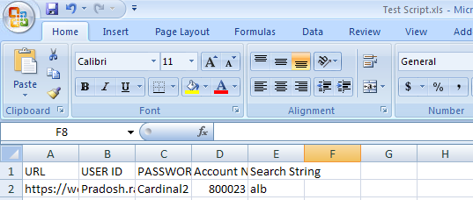
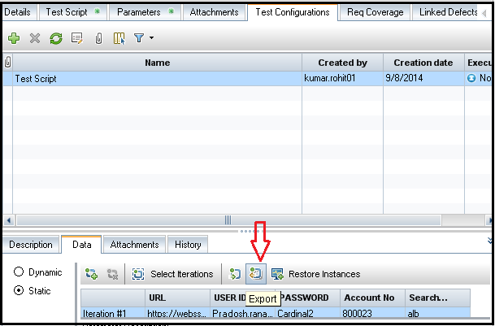
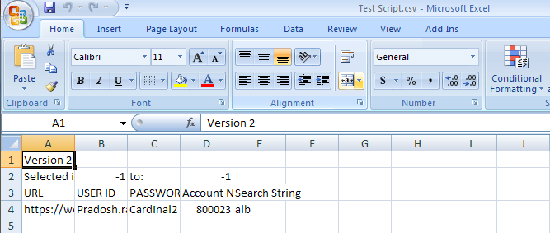
Mapping Data table to Test Configurations(Contd.)

Slide 51
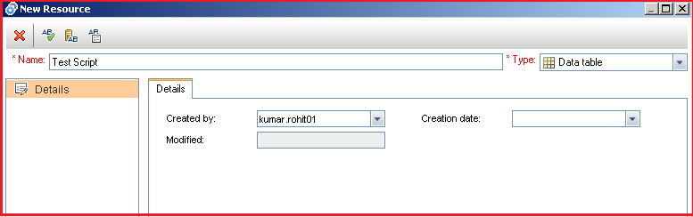
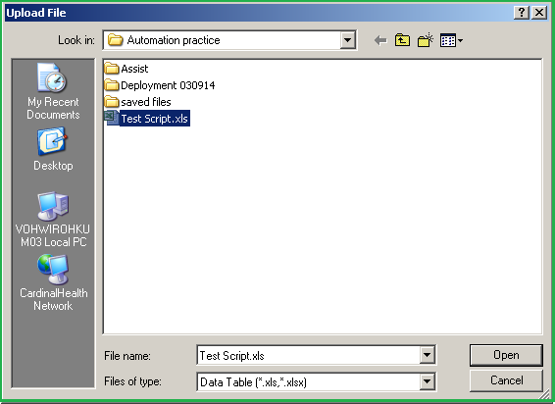
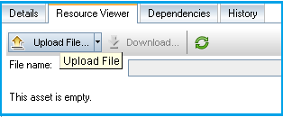
Mapping Data table to Test Configurations(Contd.)

Slide 52
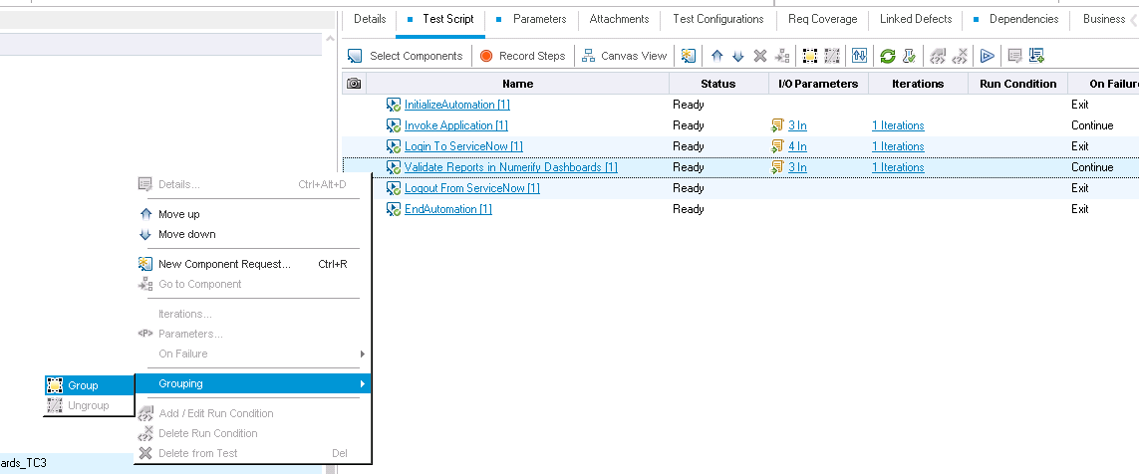
Creating Component Groups inside Test Scripts
When we want to repeat a set of components in the test flow then we prefer creating groups and thereby enhancing the business processes entailed for the test script.
Notes:
Component Group – When we want to repeat a set of components in the test flow then we prefer creating groups and thereby enhancing the business processes entailed for the test script.

Slide 53
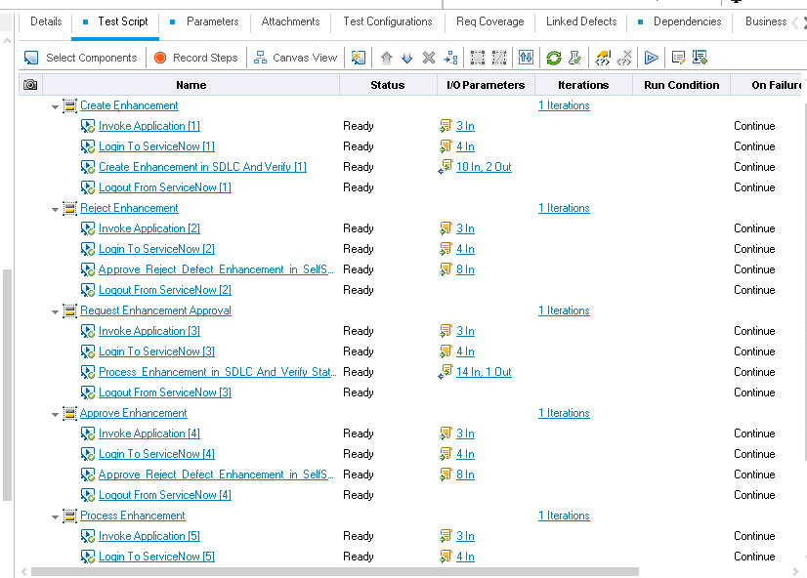
Creating Component Groups inside Test Scripts(Contd.)
Notes:
The component groups in the above flow;
Create Enhancement
Reject Enhancement
Request Enhancement Approval
Approve Enhancement
Process Enhancement

Slide 54
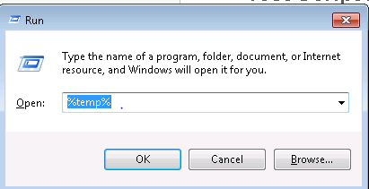
Test Script Execution in ALM (Clearing Temp Files)
Clear the Local System temp directory before proceeding with the execution in order to reduce system overheads and enhance performance.
Press Windows+R and navigate to system temp by entering %temp%.
Select all the files by pressing Ctrl+A and press Shift+Delete to permanently delete the files from the system
Post this action also empty the Recycle Bin.

Slide 55
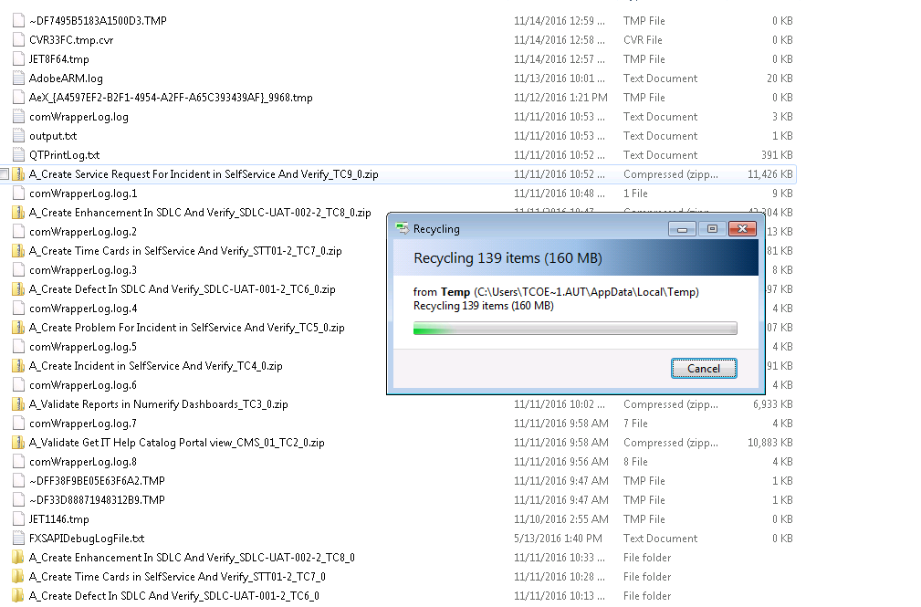
Test Script Execution in ALM (Clearing Temp Files)

Slide 56
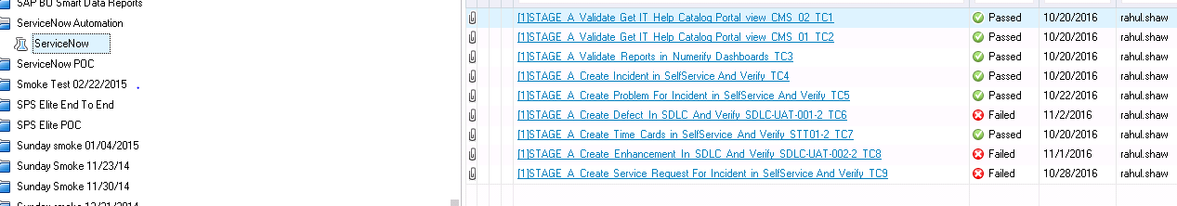
Test Script Execution in ALM
Navigate to the ALM Test Lab section.
Create a New Test Set and drag the respective test cases into the desired set.

Slide 57

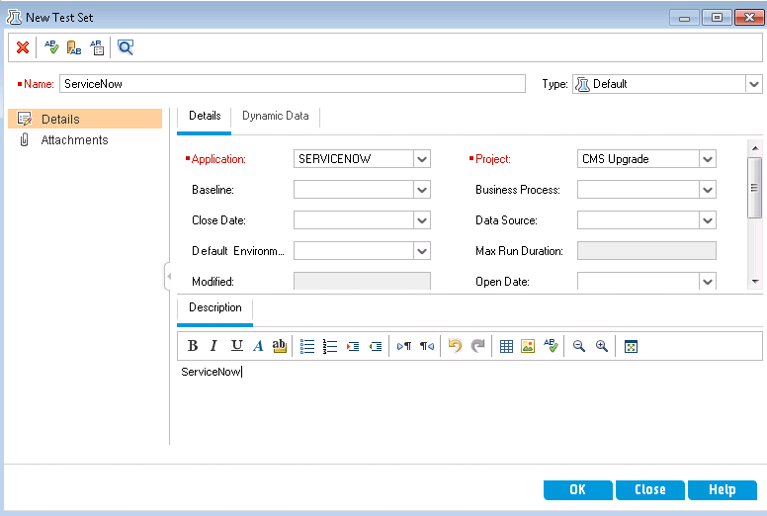
Test Script Execution in ALM (Contd.)
Click on New Test Set icon button.
_{Enter a Test set name.}
Provide the necessary information related to Application, Project, Description etc.
_{Click on OK button.}

Slide 58
Test Script Execution in ALM (Contd.)
Click on Select Tests button.
Identify the tests to be pulled into the test set.
Select the respective configuration for the particular script to be pulled.
Move the test to the desired test set by clicking on arrow icon.

Slide 59

Test Script Execution in ALM (Contd.)
Click on Run Test Set button to initiate execution of all the scripts in the set.
Usually preferred for Batch Execution.
Else select any individual script and Click on Run button to initiate respective execution.
Usually preferred for Individual Execution.

Slide 60
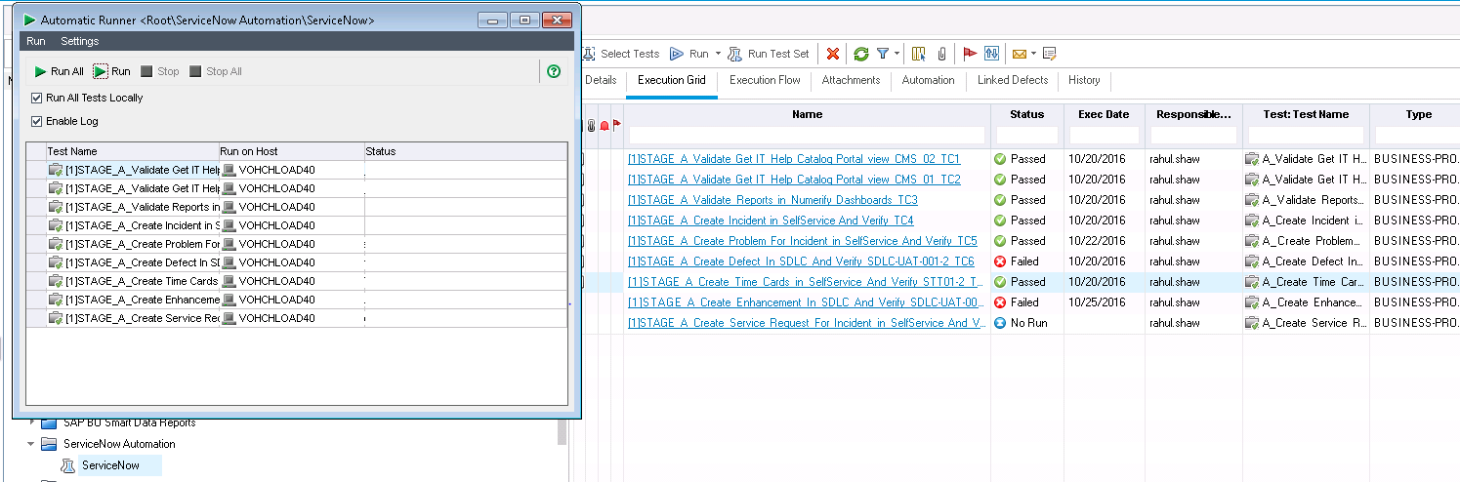
Test Script Execution in ALM (Contd.)
Batch Execution
Notes:
Click on Run All to initiate the Batch execution and make sure that the Run All Tests Locally and Enable Log checkboxes are checked.

Slide 61

Test Script Execution in ALM(Contd.)
Individual Execution

Slide 62

Test Results Analysis

Slide 63

Test Results Analysis(Contd.)

Slide 64

Test Results Analysis(Contd.)

Slide 65

Test Results Analysis(Contd.)

Slide 66

Test Results Analysis(Contd.)

Slide 67
Thank you

